Slide 1
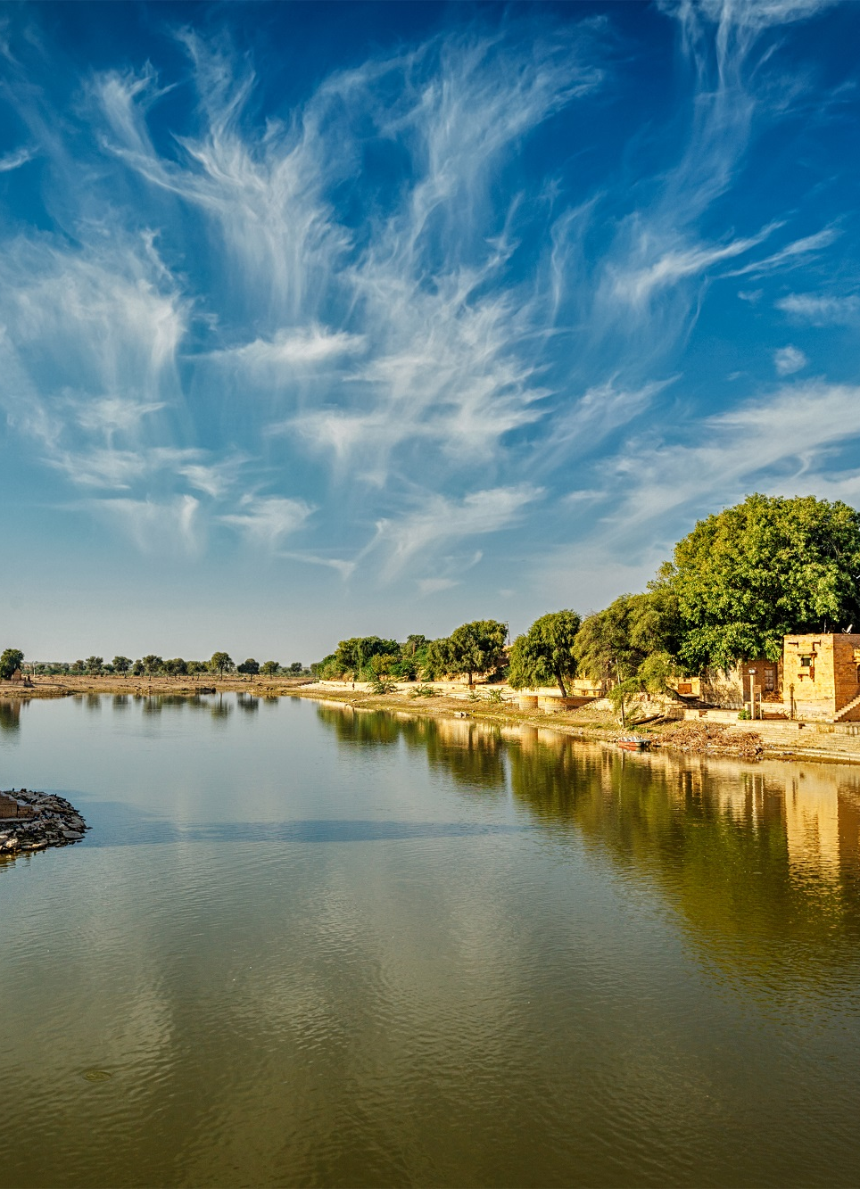
Discover the Vibrant Cultures of Nagaland and Rajasthan
Nagaland and Rajasthan are two diverse and captivating destinations in India, each offering a unique cultural tapestry waiting to be explored. From the rich heritage of Nagaland to the regal splendor of Rajasthan, this brochure will guide you through the highlights of these remarkable states.
by ROHIT Saraswat

Slide 2
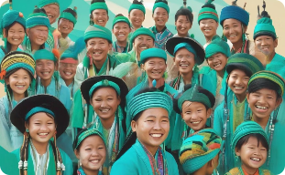
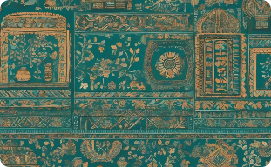
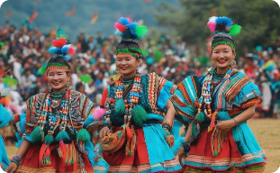
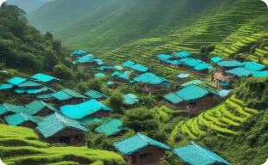
Nagaland: A Tapestry of Tradition
Diverse Tribes
Rich Cultural Heritage
Vibrant Festivals
Stunning Landscapes
Nagaland is home to a mosaic of 16 major tribes, each with its own distinct language, customs, and way of life.
From ancient folklore to captivating folk art, Nagaland's cultural legacy is a testament to the resilience and ingenuity of its people.
Celebrations like the Hornbill Festival showcase the state's vibrant traditions, music, and dance, captivating visitors from around the world.
Nagaland's breathtaking terrain, from rugged mountains to lush valleys, offers a serene backdrop for immersive cultural experiences.

Slide 3
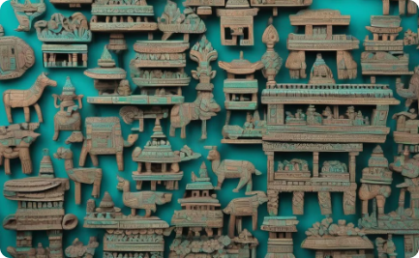
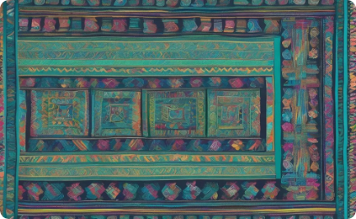
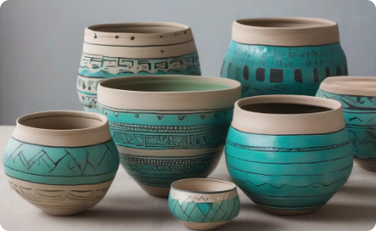
Nagaland's Captivating Folk Art
Woodcarving
Weaving
Pottery
Naga artisans create intricate woodcarvings, often depicting scenes from their rich cultural heritage and daily life.
Naga women are renowned for their skilled weaving, producing vibrant textiles with intricate motifs and designs.
Naga potters craft unique earthenware vessels, often adorned with traditional symbols and patterns.

Slide 4
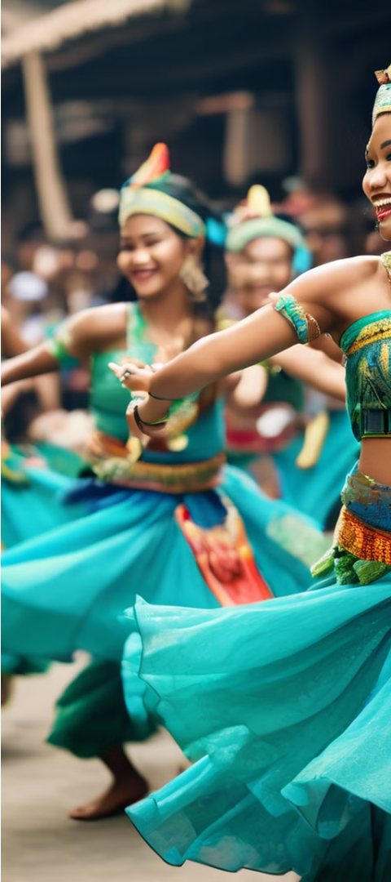
Festivals and Traditions of Nagaland
1
Hornbill Festival
An annual celebration showcasing the diverse cultures of Nagaland, featuring music, dance, and traditional games.
2
Sekrenyi Festival
A sacred festival celebrated by the Angami tribe, marked by rituals, feasting, and the renewal of community bonds.
3
Moatsu Mong
A spring festival celebrated by the Ao tribe, involving traditional dances, feasting, and the strengthening of social ties.

Slide 5

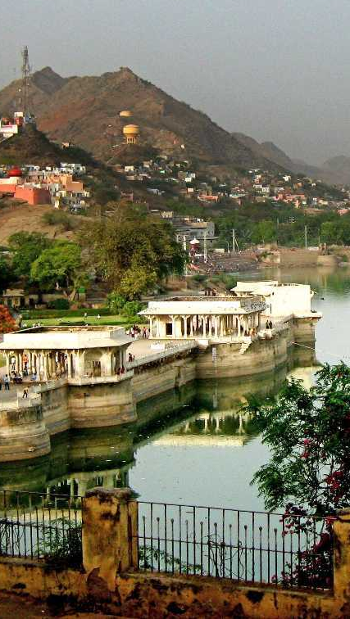
Rajasthan: A Regal Affair
Rajasthan, the "Land of Kings," is a mesmerizing tapestry of royal heritage, captivating landscapes, and vibrant cultural traditions. From the grand medieval fortresses to the vibrant markets, Rajasthan beckons visitors to immerse themselves in its regal splendor.
Renowned for its magnificent palaces, Rajasthan offers a glimpse into the opulent lifestyles of its former royal dynasties. Explore the intricate architecture, ornate interiors, and well-preserved history that permeates these architectural marvels. The iconic Amber Fort, Mehrangarh Fort, and City Palace in Udaipur are just a few of the must-see destinations that showcase Rajasthan's enduring royal legacy.
Beyond the palatial grandeur, Rajasthan captivates with its vibrant cultural tapestry. Witness the skilled artisanry of local craftspeople, from the renowned Rajasthani textiles and carpets to the breathtaking miniature paintings. Immerse yourself in the rhythmic beats of traditional music and dance, which have been passed down through generations, and savor the rich, flavorful cuisine that reflects the region's diverse culinary influences.
From the sun-drenched deserts of Thar to the serene lakes and verdant hills, Rajasthan's natural beauty is truly breathtaking. Embark on camel safaris, explore the rugged terrain on horseback, or simply bask in the tranquility of the countryside, where time seems to stand still. Rajasthan's captivating landscapes provide the perfect backdrop for a truly unforgettable cultural odyssey.

Slide 6
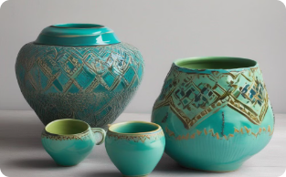
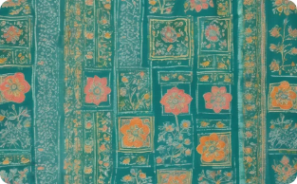
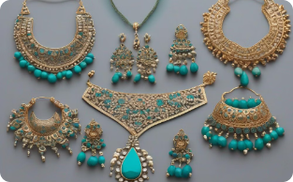
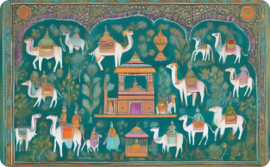
Rajasthan's Renowned Craftsmanship
Pottery
Textiles
Jewelry
Miniature Painting
Rajasthan is renowned for its intricate and colorful pottery, crafted with traditional techniques.
From vibrant block prints to delicate embroidery, Rajasthan's textile heritage is a visual delight.
Rajasthani artisans create stunning jewelry, including intricate silver and gold pieces.
The state's rich artistic legacy is showcased in the delicate and intricate miniature paintings.

Slide 7

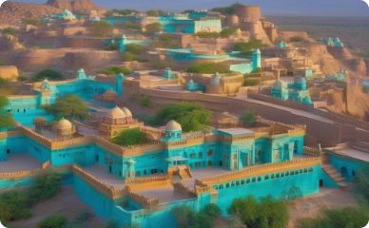
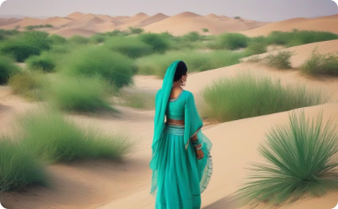
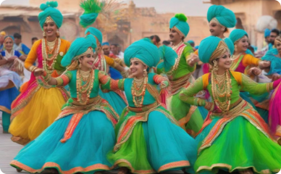
Regal Splendor of Rajasthan
Forts and Palaces
Desert Landscapes
Cultural Immersion
Discover the grand fortresses and opulent palaces that have witnessed Rajasthan's illustrious history.
Explore the captivating desert scenery, including the vast dunes and serene oases.
Immerse yourself in Rajasthan's vibrant festivals, traditional music, and culinary delights.

